Slide 1


PCF Operations Workshop -
Health, Events, & Logging
<Presenter>
<Title>

Slide 2


Services Overview
Platform Installation & Setup
Role Based Access Control
Platform & Application Scaling
Health, Events, & Logging
Platform & Application Patching
Security Overview
Authentication & Authorization
Operations Workshop Agenda

Slide 3

Key Themes
Speed
Scale
Security
Stability

Slide 4
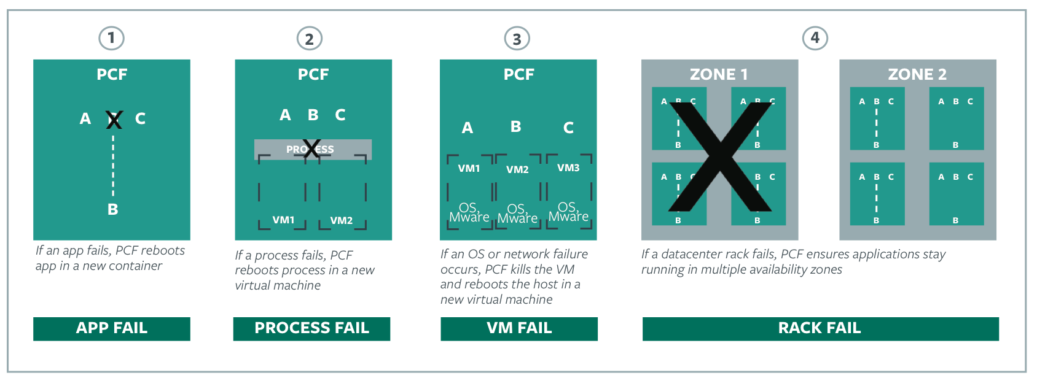
4 Layers of Self Healing

Slide 5
Scenario 1: Application Failure & Recovery
The Elastic Runtime monitors application instance processes, and detects failures
On failed instances, the container is destroyed and a new container is created
Droplet is copied from the Cloud Controller blobstore to the container and started
cf push my-app -i 4
ELASTIC RUNTIME
App Execution
App Execution
inst-1
inst-2
X
inst-3
inst-4
AZ-1
AZ-2

Slide 6
Scenario 2: Process Failure & Recovery
Monit utility running on the component VMs automatically restarts failed processes
BOSH release defines which processes to monitor

Slide 7
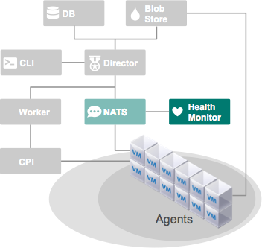

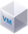
Scenario 2: Process Failure & Recovery
Alert: process failure
component
process fails

Slide 8
Scenario 2: Process Failure & Recovery
component
process
recovered

Slide 9
Scenario 3: VM Failure & Recovery
Each component of Cloud Foundry is a VM deployed and managed by BOSH
BOSH health monitor continuously compares current component state to desired state, including:
number of instances
running processes
If current state differs from desired state, the health monitor:
triggers the VM resurrector, or
sends alerts

Slide 10
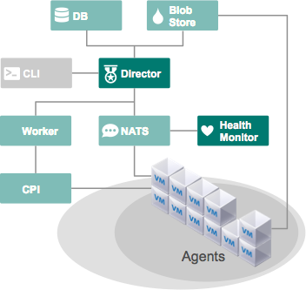
Scenario 3: VM Failure & Recovery
Alert: VM down
desired state
actual state

Slide 11
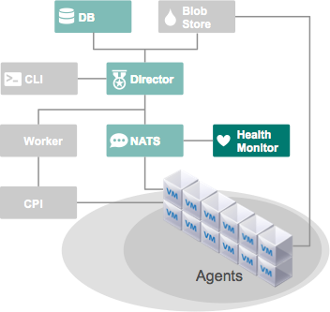
Scenario 3: VM Failure & Recovery
desired state
actual state
failed VM restored

Slide 12
Scenario 4: AZ Failure & Recovery
If one zone fails, the application instances in the other zone pick up the load
No outage
cf push my-app -i 4
ELASTIC RUNTIME
X
App Execution
App Execution
inst-1
inst-2
inst-3
inst-4
AZ-1
AZ-2

Slide 13
Health, Events, & Logging
Application Failure Demo

Slide 14
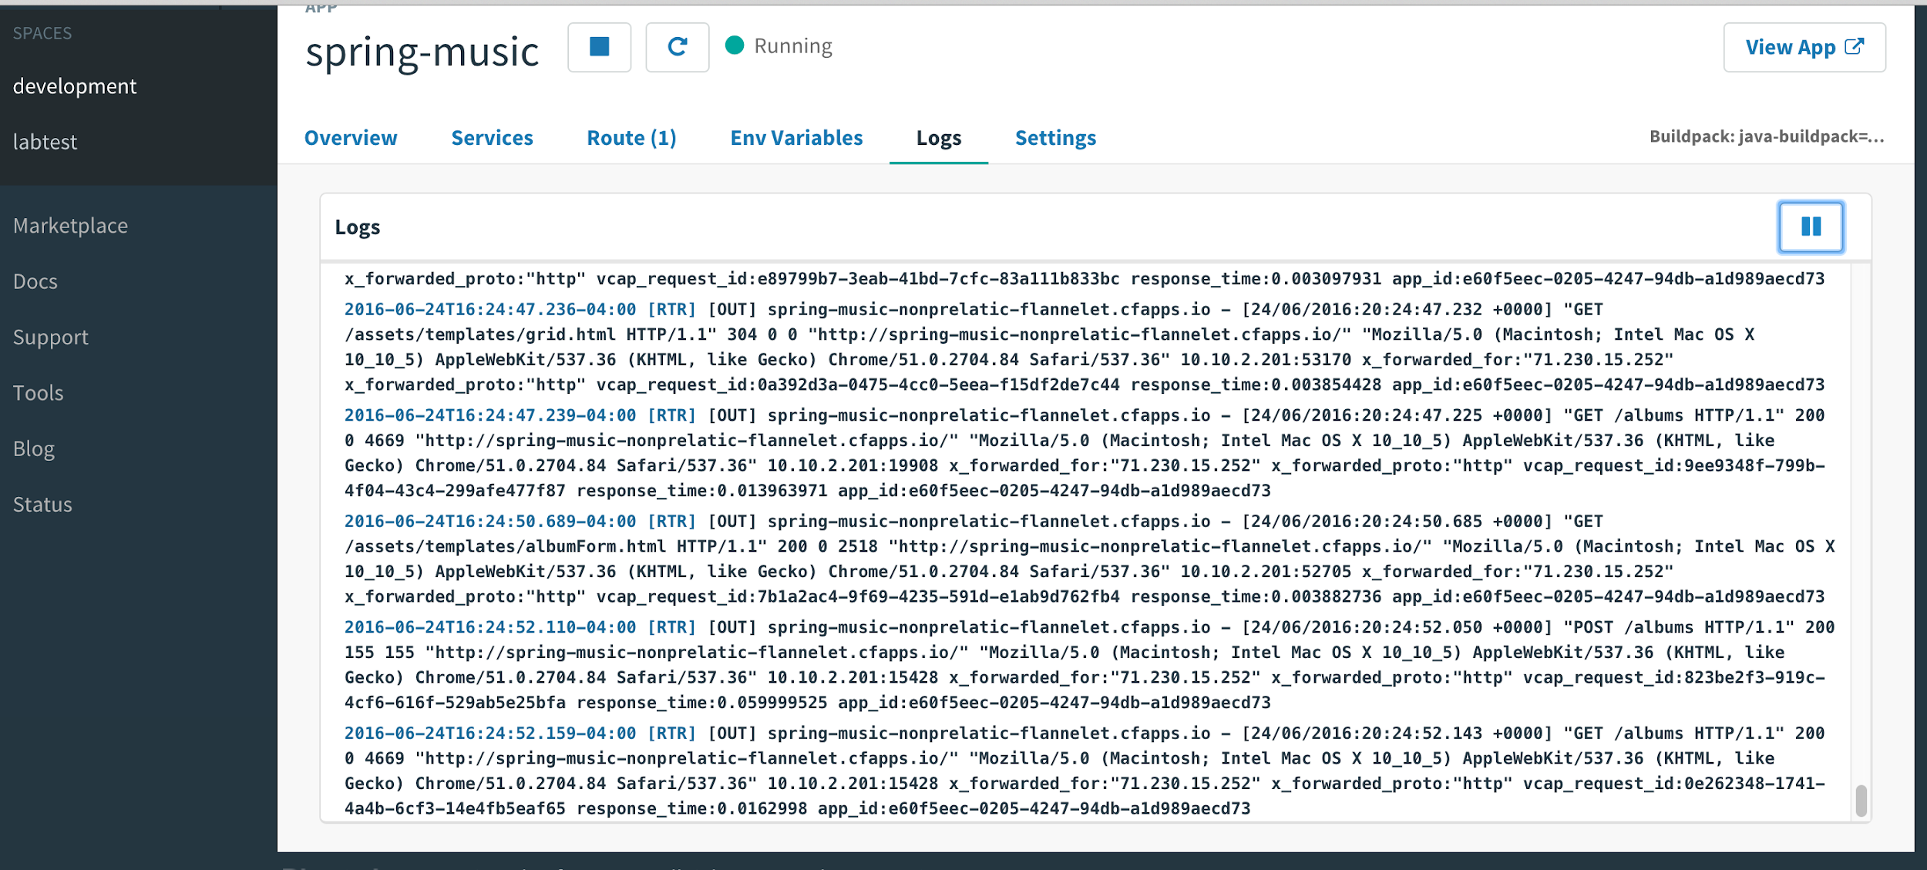
Logging
Available through the CLI and Apps Manager
Application layer log aggregation provides consolidated view across all application instances and Routers.
Ability to tail logs for real-time aggregated analysis
Flush logs to permanent storage

Slide 15
Loggregator - The Voice of the System
Provides logging and metrics for the Elastic Runtime
A modern approach to logging that emphasizes:
Support for ephemeral, container-based applications
Productivity by streaming logs and metrics to operators and developers (no log shipping)
Accessibility and visibility into your applications and the platform
Seamless integration with modern log management services (e.g. Splunk, LogStash)

Slide 16
How can Loggregator help me?
Debugging applications
Application insights
Monitoring system and application health
Exporting metrics into visualization tools

Slide 17
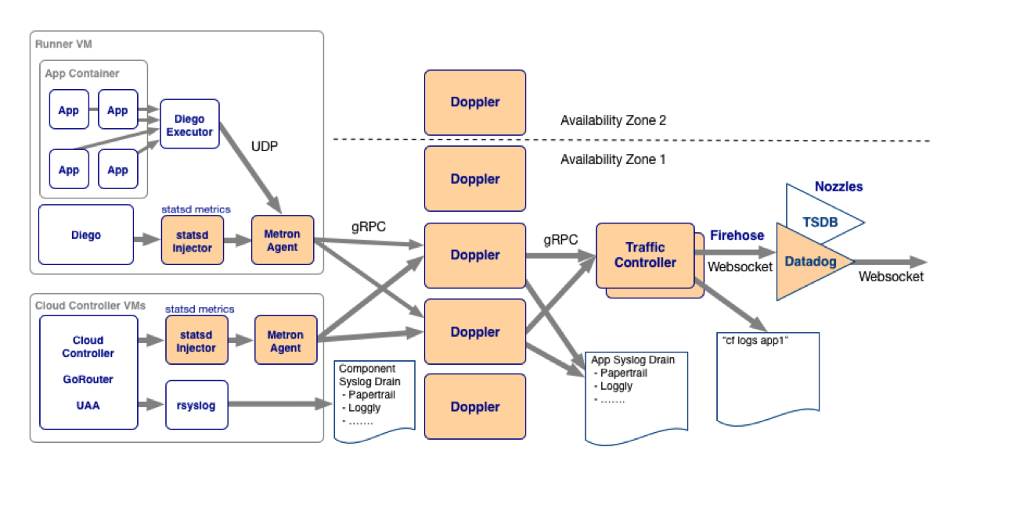
Loggregator System

Slide 18
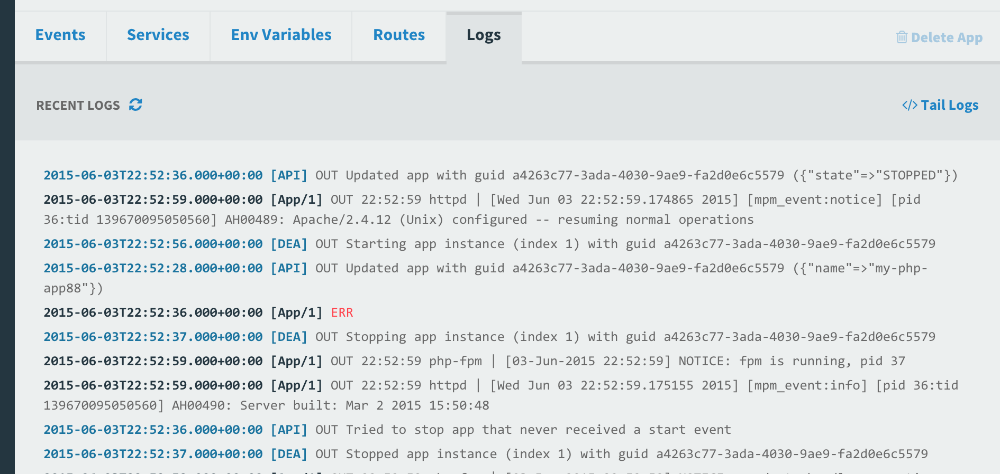
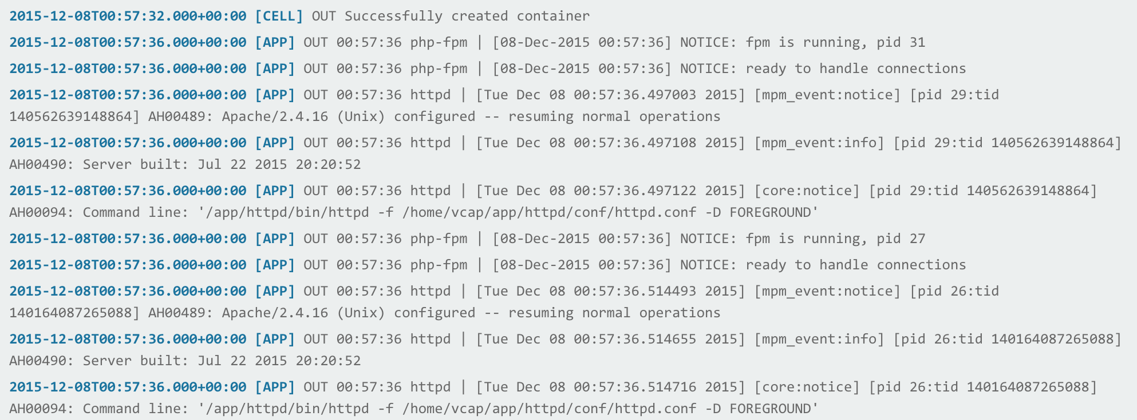
Viewing App Logs Using Apps Manager
In Apps Manager, select your app, then select Logs

Slide 19
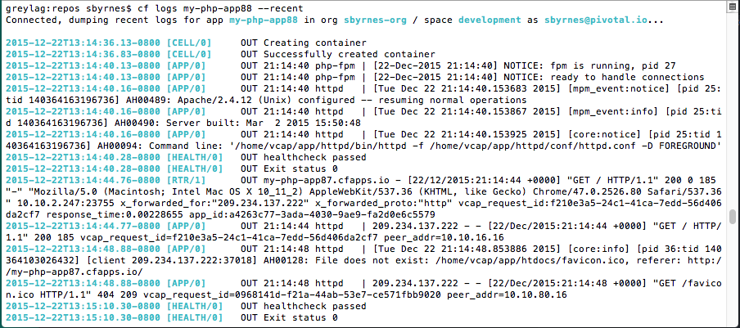
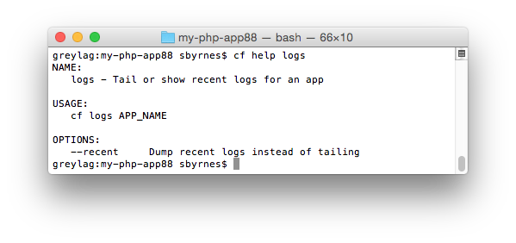
Viewing Logs For an App Using the cf CLI
Use “cf logs <app_name> --recent” to see recent logs
Use “cf logs <app_name>” to tail application logs

Slide 20
cf logs- Behind the Scenes
A component of the Loggregator system called the Traffic Controller receives and responds to requests for logs and metrics
Cloud Foundry
Elastic Runtime
Router
Loggregator Traffic Controller
cf logs MyApp

Slide 21
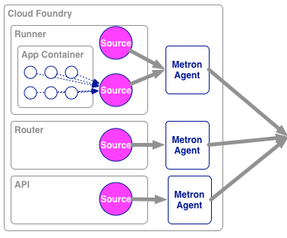
cf logs MyApp- Deeper Behind the Scenes
Sources of logging and metrics data send data to Metron Agents, which reside on Cloud Foundry components
The Metron Agents send the data to Doppler Servers
When the request for logs is made, the Traffic Controller gets the data from the Doppler Servers
Cell
cf logs MyApp
Traffic
Controller(s)
Doppler
Server(s)
Cloud Controller

Slide 22
Health, Events, & Logging
Logging Demo

Slide 23
Firehose and Nozzles
Traffic Controllers have a Firehose endpoint
The Firehose streams all the event data coming from an Elastic Runtime deployment
Includes application logs, HTTP events and container metrics
Includes metrics from all Elastic Runtime components
Does not include Elastic Runtime component logs
Operators can deploy nozzles to the Firehose endpoint, which listen for a subset of data from the Firehose
Cell
Nozzles
Datadog
Traffic
Controller(s)
Doppler
Server(s)
Open TSDB
Firehose
Cloud Controller

Slide 24
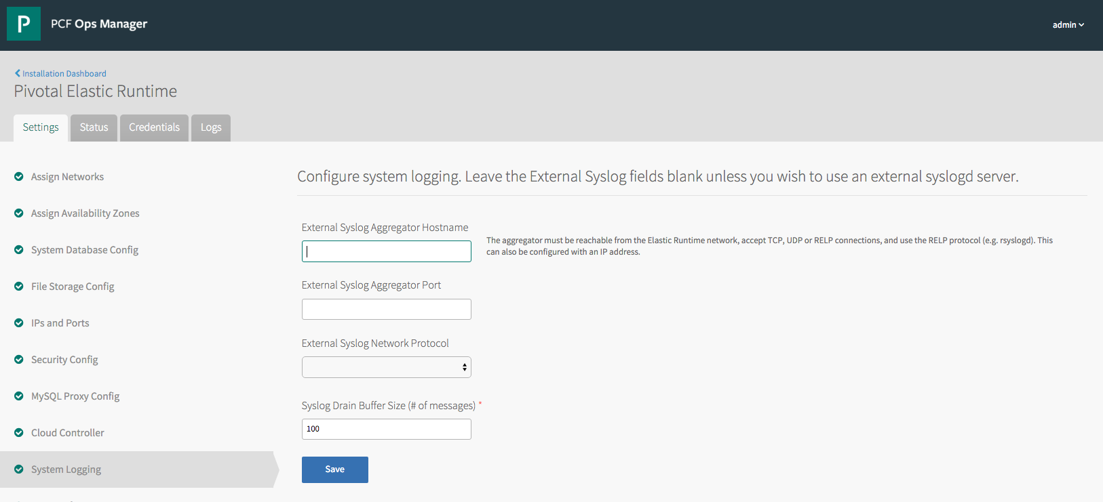
Platform syslog
Elastic Runtime can send system logs to an external syslog server
Configure this in the System Logging tab

Slide 25
Syslog Drains
Syslog drains allow data related to an application to be sent to third-party log managers
The data from the Doppler Servers is sent to the Syslog drain
The Traffic Controller is not used
Cell
Traffic
Controller(s)
Doppler
Server(s)
Cloud Controller

Slide 26
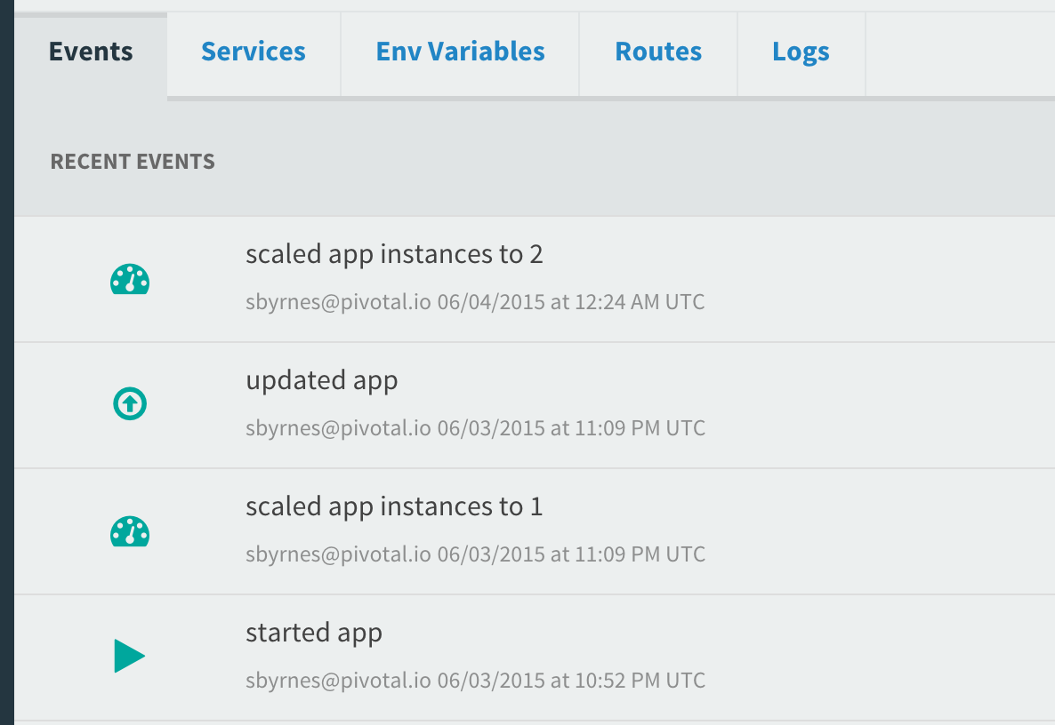
Viewing the Events for your App
In Apps Manager, select your app, then select Events
Or in the cf CLI cf events <my-app-name>

Slide 27
Health, Events, & Logging
Events Demo

Slide 28
Application Performance Monitoring
PCF Metrics provides a real-time application monitoring dashboard
3rd Party Tiles provide in-depth monitoring of applications running on PCF via an embedded agent bundled with applications that are deployed using Buildpacks
Dynatrace
New Relic
AppDynamics

Slide 29
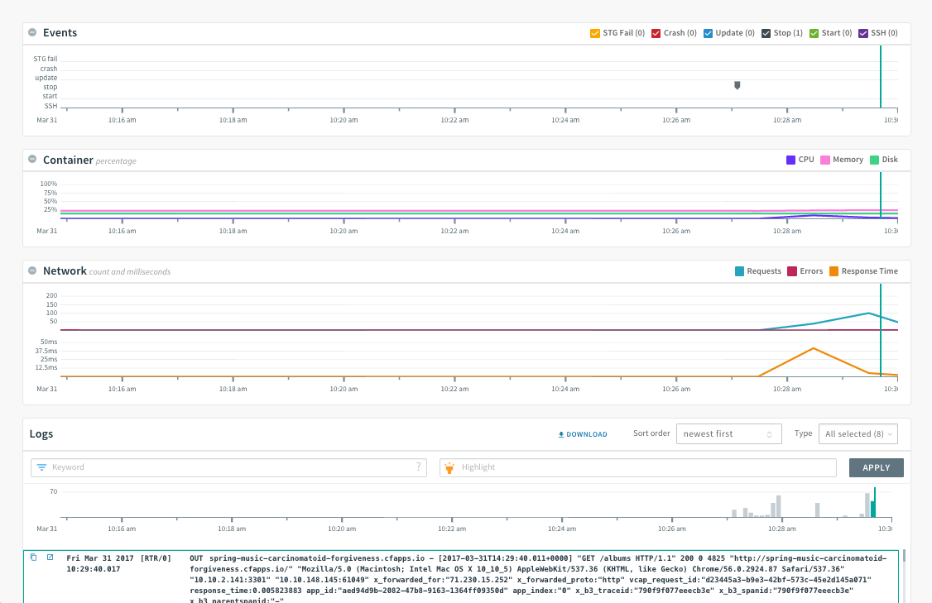
PCF Metrics

Slide 30
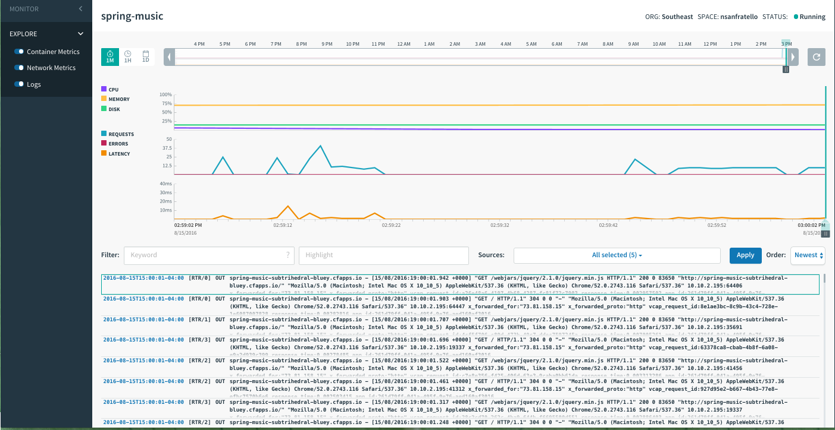
PCF Metrics | Logging Integration

Slide 31
Health, Events, & Logging
Metrics Demo

Slide 32
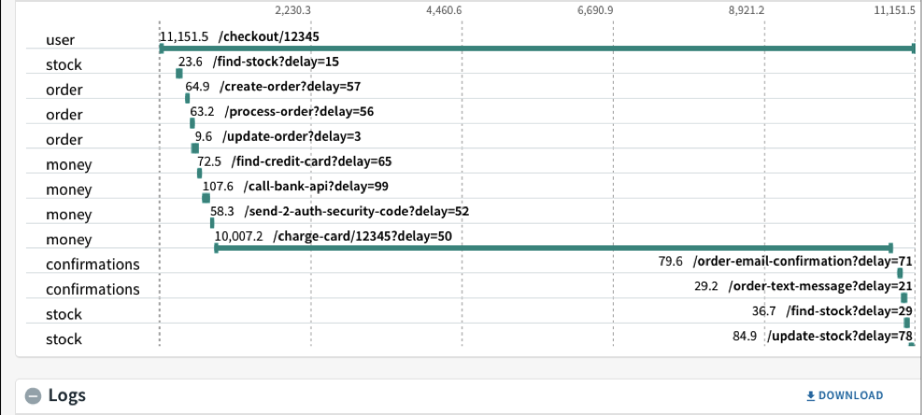
PCF Metrics | Distributed Tracing

Slide 33
PCF JMX Bridge
Collects and exposes system data from PCF components via a JMX endpoint (Cloud Controller, Router, Diego, VMs, etc)
Composed of the following VMs:
JMX provider
VM that governs compilation
Nozzle for the Loggregator Firehose
Rebranded version of “Pivotal Cloud Foundry Ops Metrics”

Slide 34
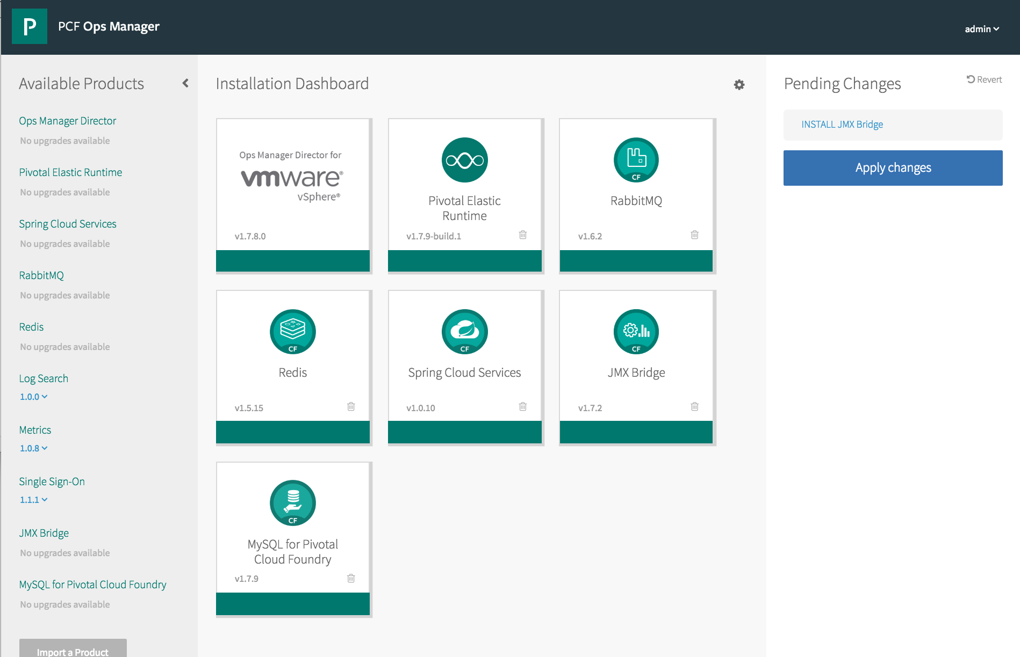
JMX Bridge Installation - Tile

Slide 35
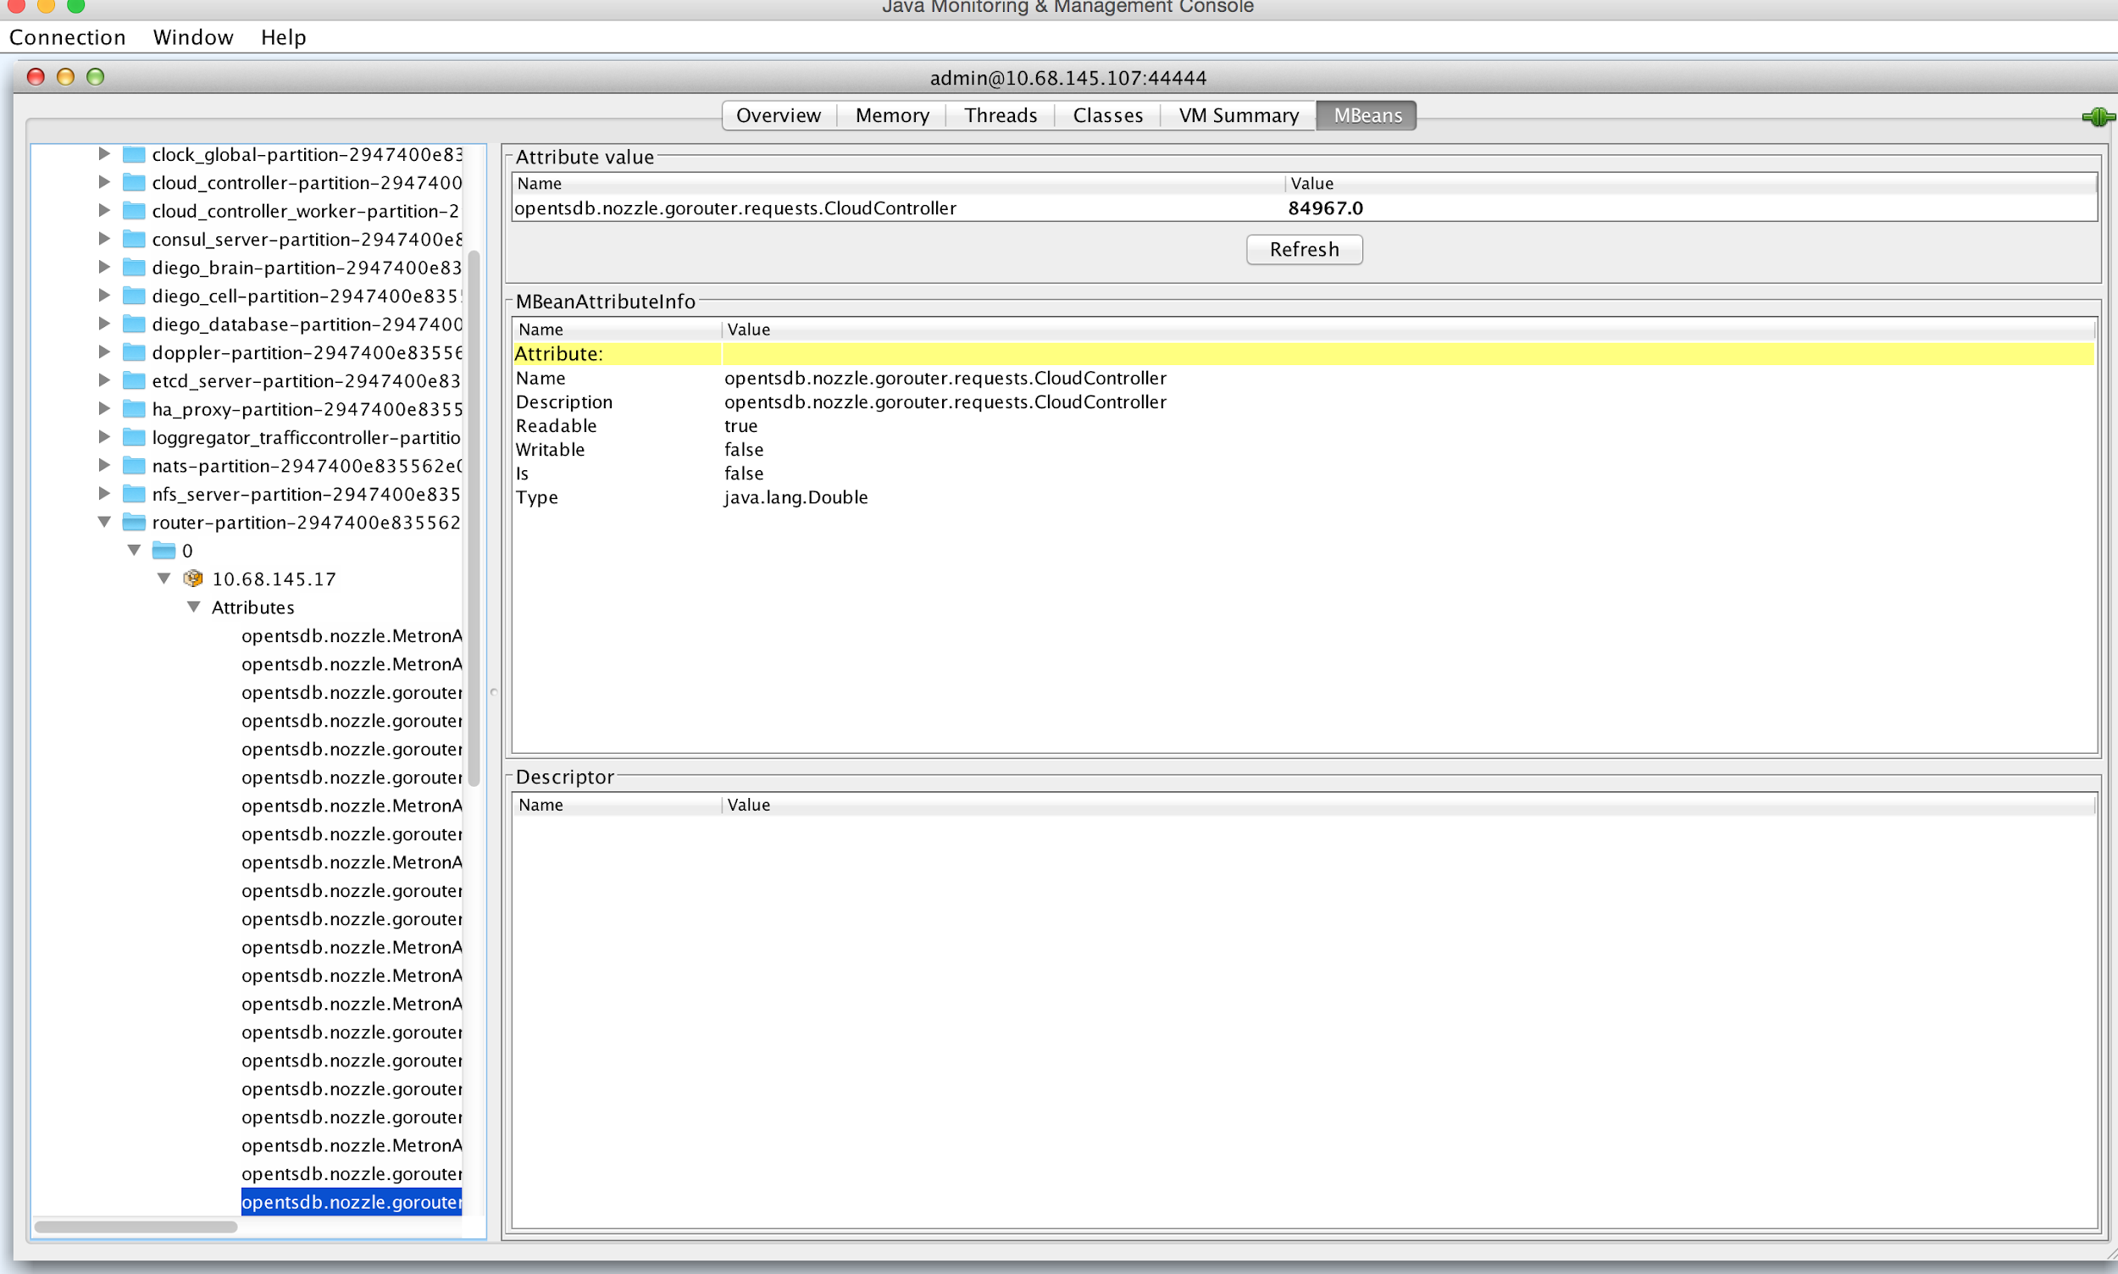
Stats – Router Requests

Slide 36
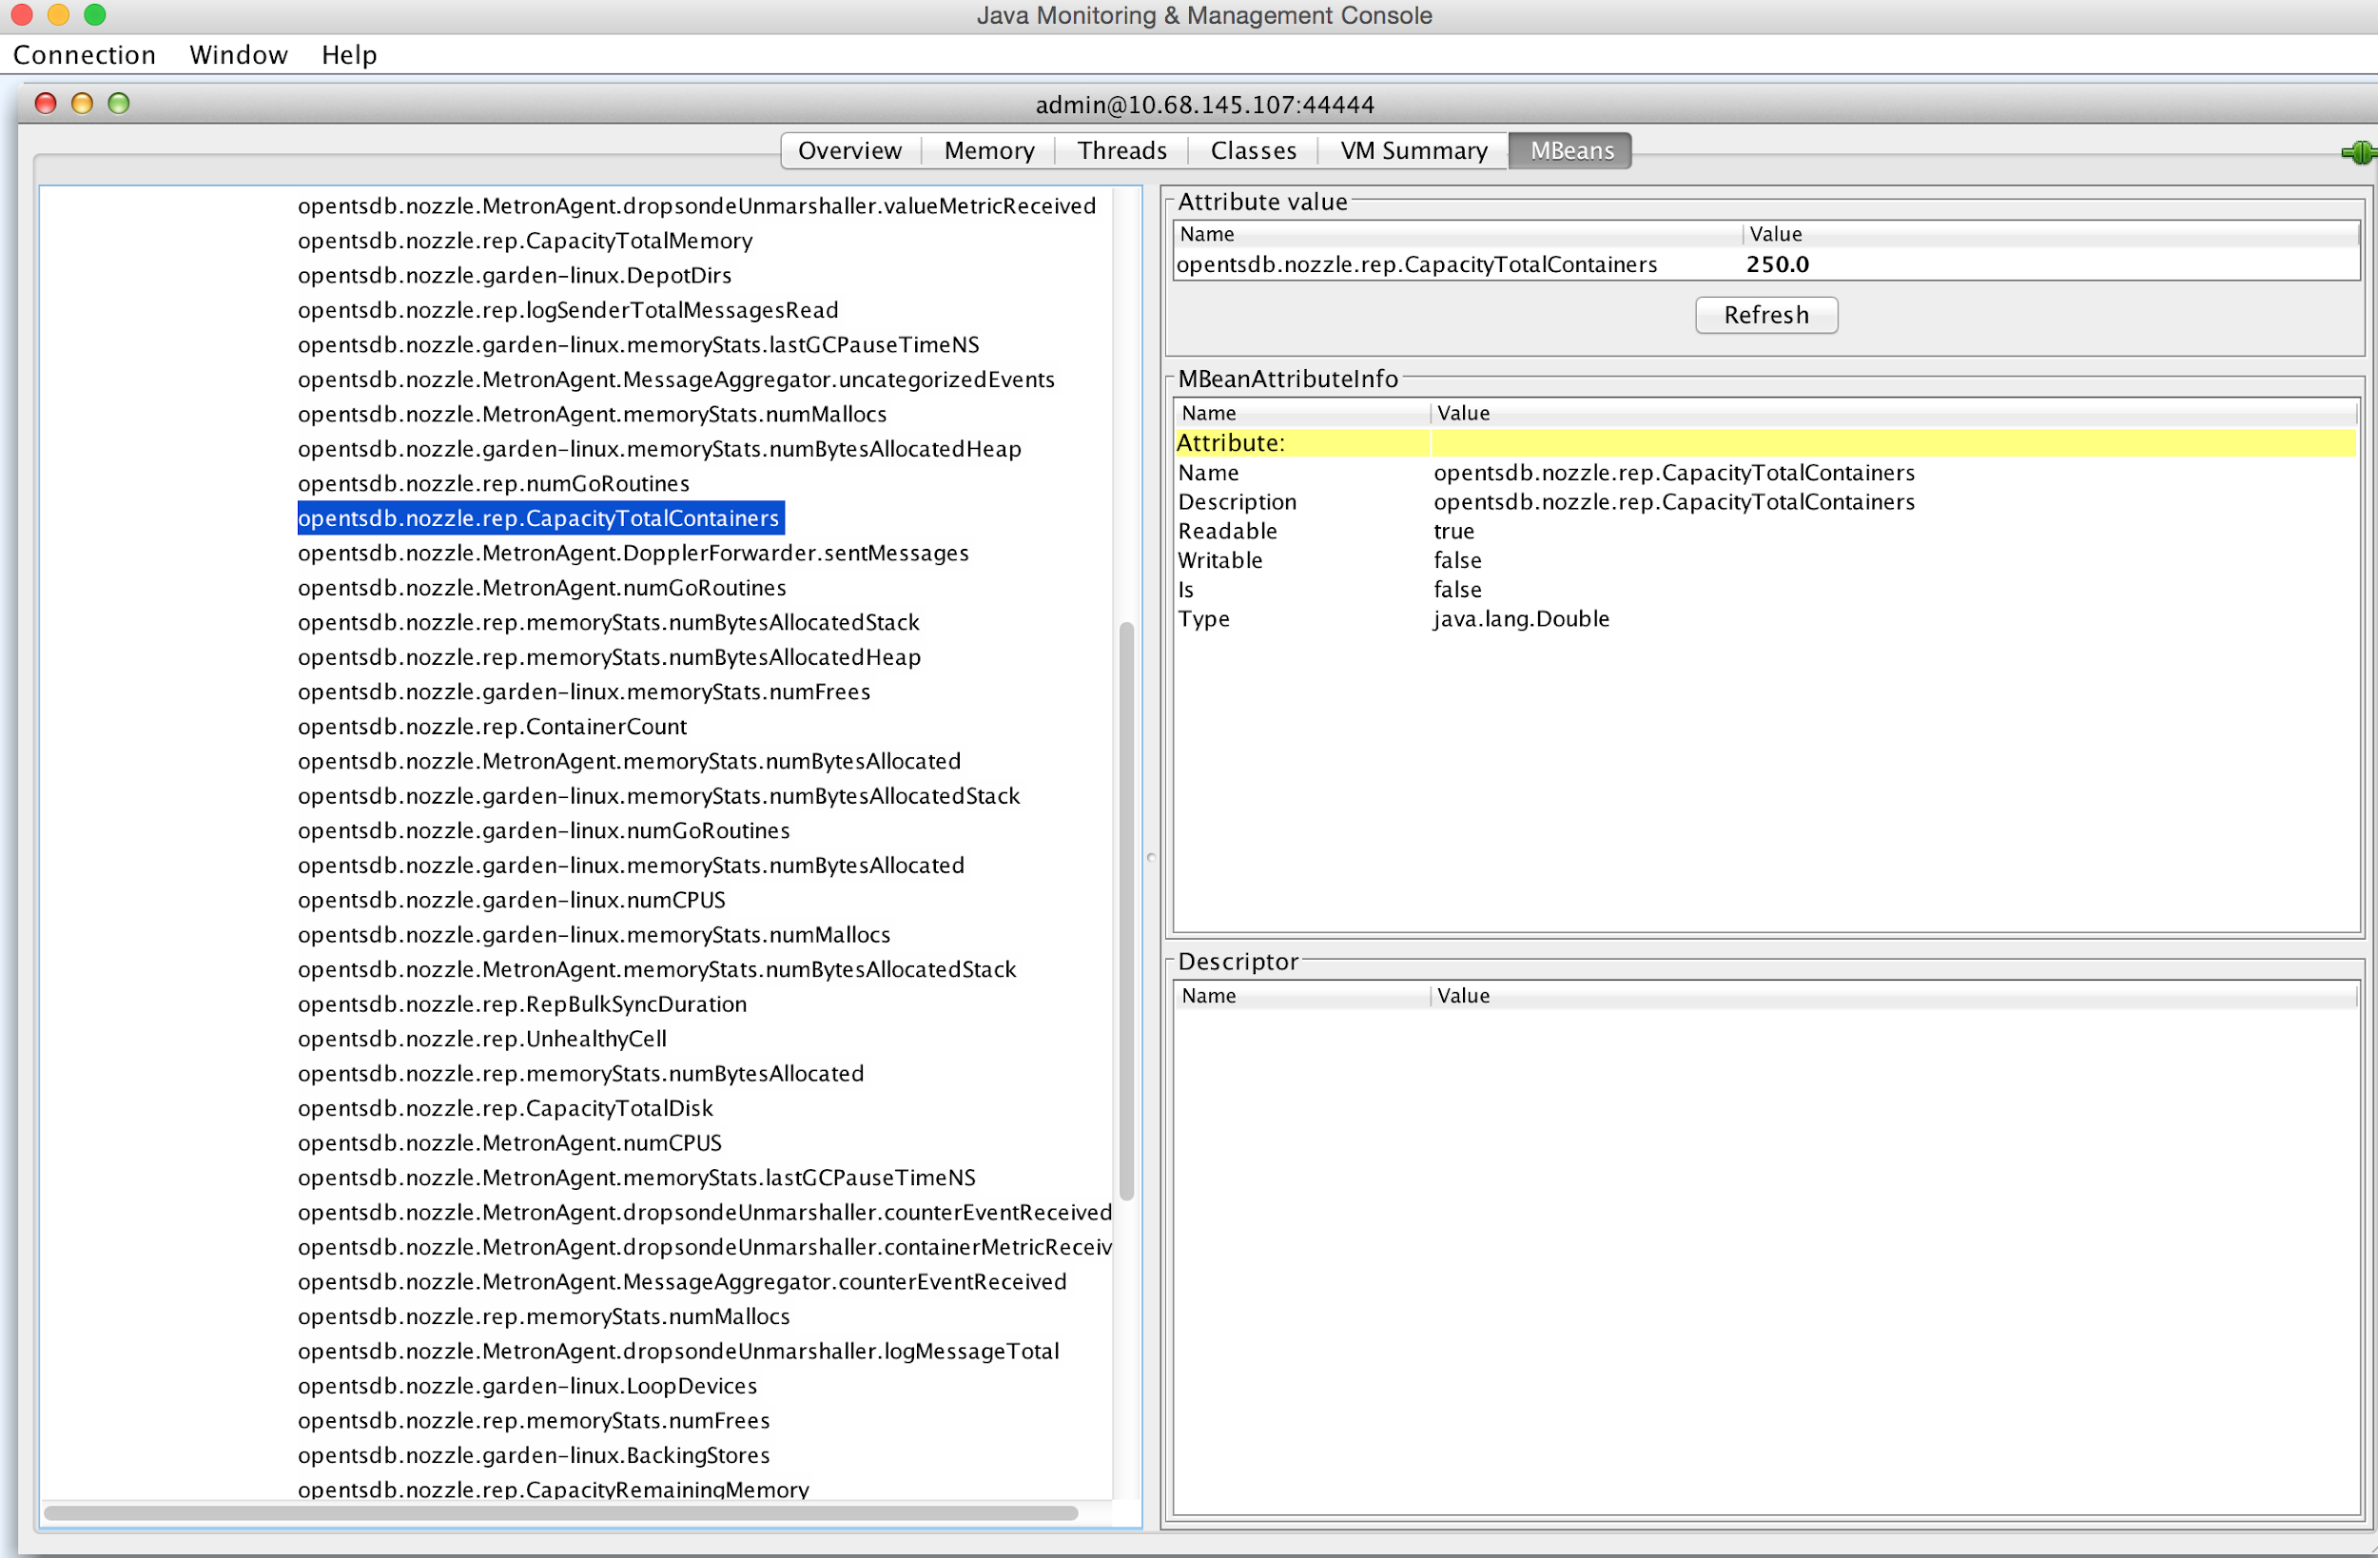
Stats – Cell Container Capacity

Slide 37
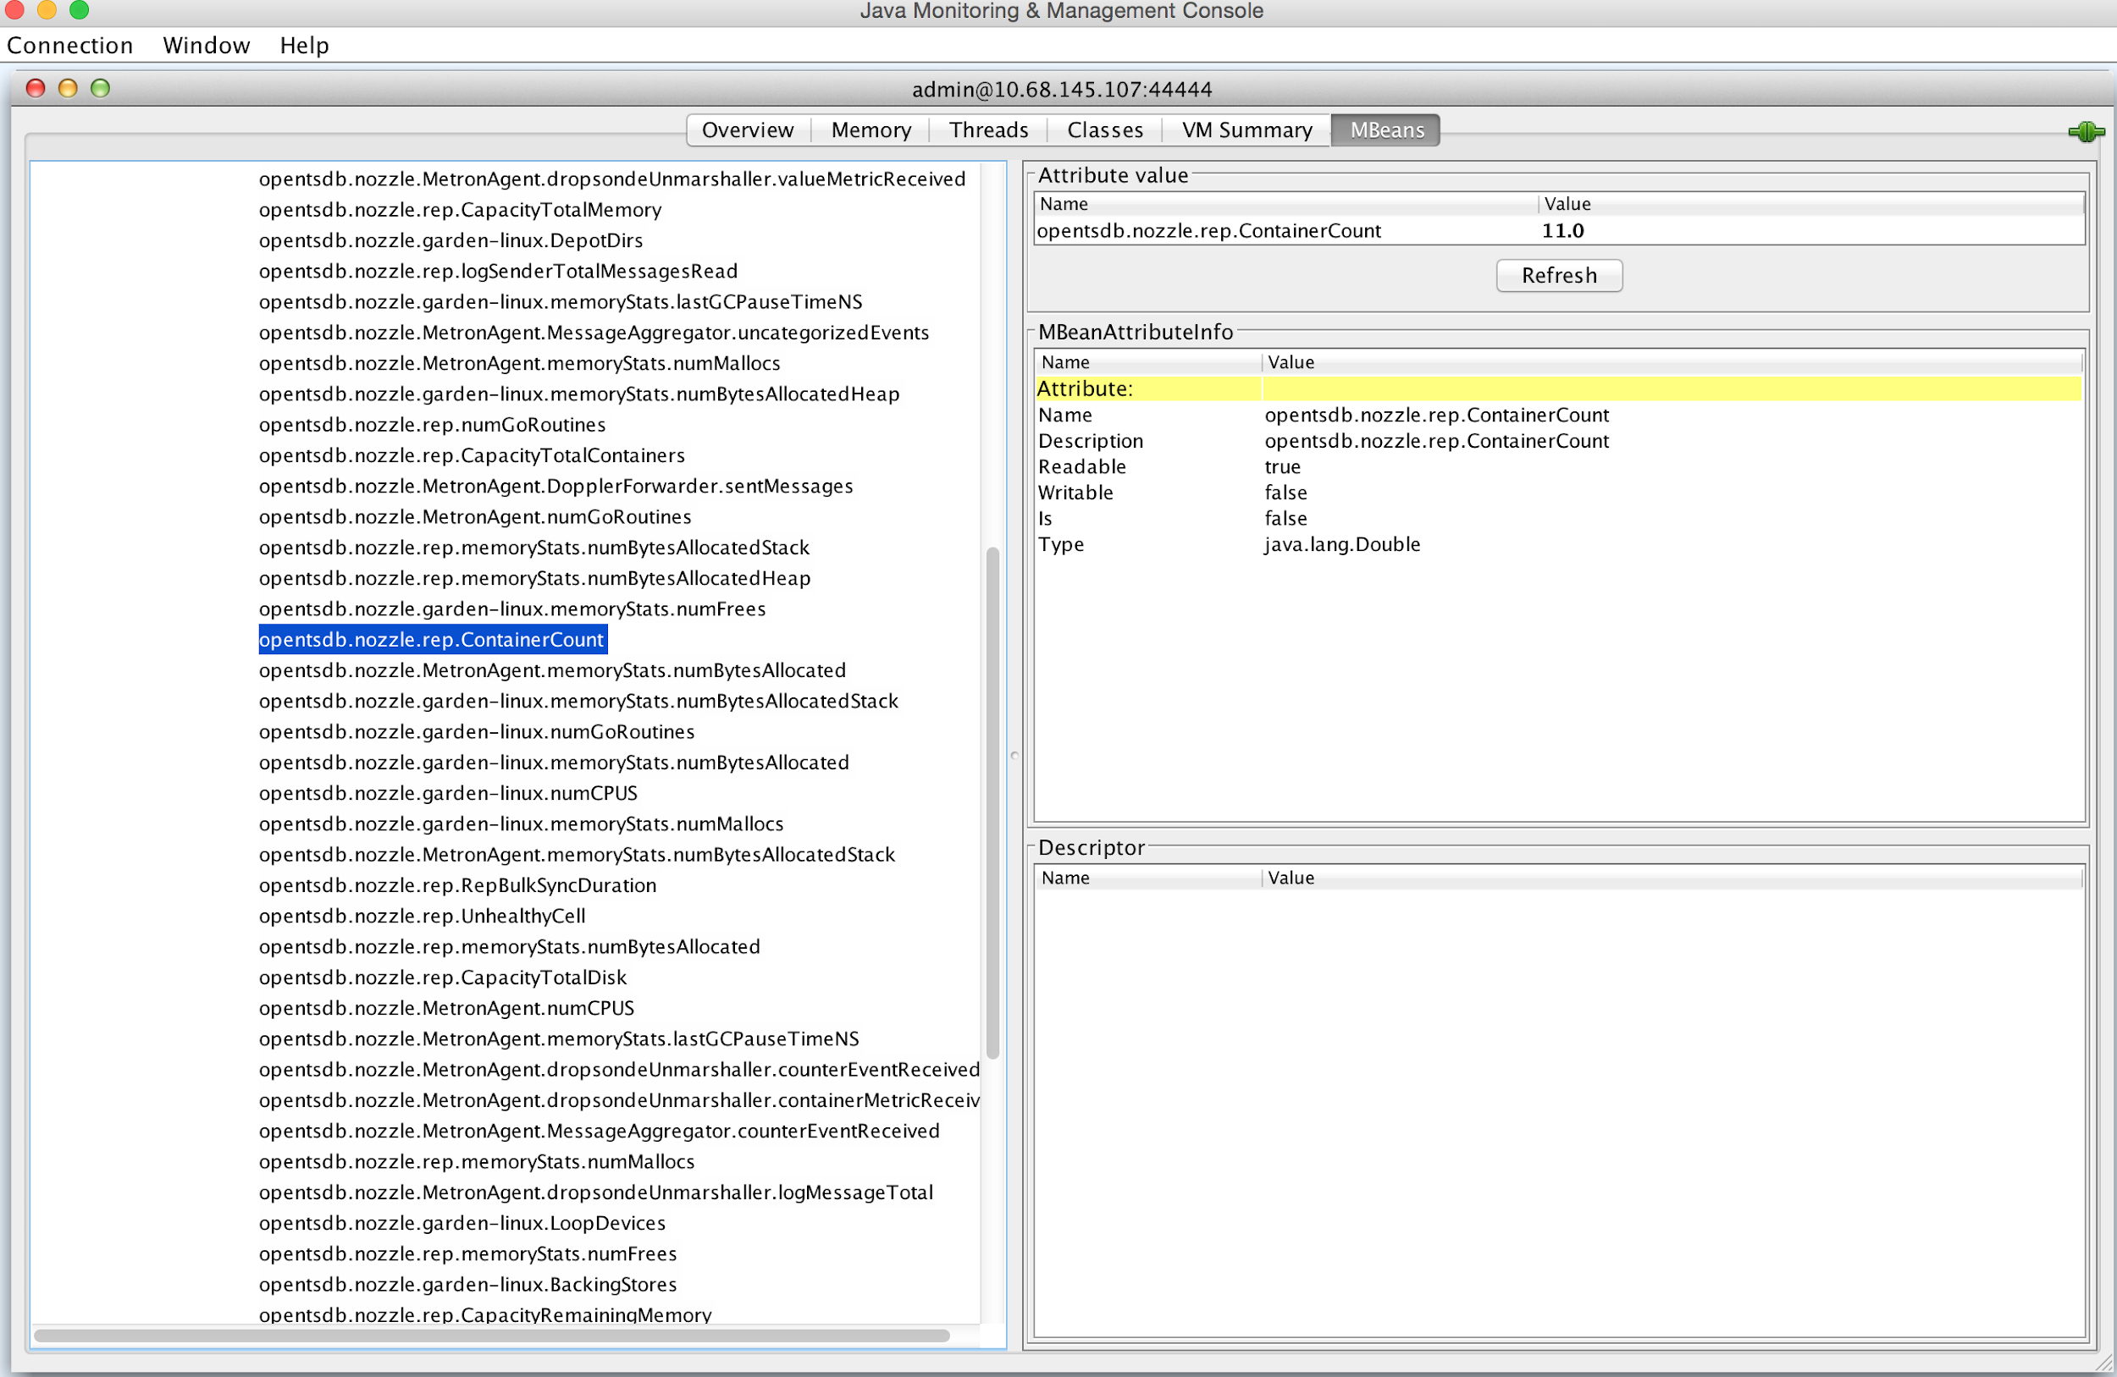
Stats – Cell Containers Running

Slide 38
Health, Events, & Logging
Ops Manager BOSH Health Demo

Slide 39
Questions
What monitoring tool(s) do you use for infrastructure and applications?
What logging tool(s) do you use for centralizing logs?
Do you have the ability to stream aggregated logs for an application?

